Slide 1
Binary Search Tree
CPSC 131 - Data Structure
Shrinivas Patil

Slide 2
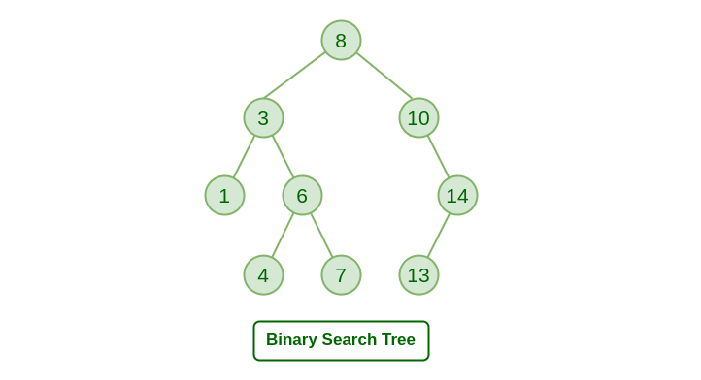
Binary Search Tree
Node based binary tree
Left subtree contains all values less than key of node
Right subtree contains all values greater than key of node
Left and right subtree both should be binary trees

Slide 3
Binary Tree versus Binary Search Tree (BST)
Binary Node has
value
left child pointer
right child pointer
parent pointer
Binary Tree: structure with
Root node
Size
No rule for how keys are organized
Binary Search Tree (BST): binary tree AND the keys obey the BST order invariant

Slide 4
BST Order Invariant
BST Order Invariant:
Key data type must be comparable; supports < and ==
For any parent node p and descendant d
If d is in p’s left subtree, then d.key < p.key
If d is in p’s right subtree, then d.key > p.key
Informally
left subtree < parent < right subtree
61
<61
>61

Slide 5
BST operations
Insertion
Deletion
Search
Traversal
Preorder
Inorder
Postorder

Slide 6
Example: Menu Prices
“Fries”
“Burger”
“Soda”
Key | Value
“Burger” | 2.99
“Salad” | 3.99
“Fries” | 1.99
“Soda” | 1.49
“Salad”

Slide 7
Example: Volume Units
“pint”
Key | Value
“tsp” | 4.39
“tbsp” | 14.8
“oz” | 29.6
“cup” | 237
“pint” | 437
“quart” | 946
“cup”
“tbsp”
“oz”
“quart”
“tsp”

Slide 8
Keys are Unique
BST Order Invariant uses strict < inequality
Not ≤
Implies that BST keys must be unique (no duplicates)
37
✔ OK
✘ order invariant violation
37
61
55
83

Slide 9
Inorder Traversal is Sorted
Inorder traversal:
Visit left subtree
Visit node
Visit right subtree
BST Order Invariant: (left subtree) < node < (right subtree)
Together, imply: inorder traversal of a BST visits keys in increasing order
7

Slide 10
Inorder Traversal is Sorted
“pint”
37
“cup”
“tbsp”
61
55
83
“oz”
“quart”
“tsp”
Inorder: cup, oz, pint, quart, tbsp, tsp (alphabetical)
Inorder: 37, 55, 61, 83
(strict increasing order)

Slide 11
Multiple Valid Tree Shapes
BST Order Invariant does not make trees completely rigid
When n ≥ 2, there are multiple legal shapes
This allows restructuring
Soon: restructure trees to maintain low height
1
2
2
1

Slide 12
Multiple Valid Tree Shapes
37
37
61
55
55
83
61
83
37
55
83
61

Slide 13
Height is Still Between O(log n) and O(n)
Height analysis of plain binary trees also applies to BSTs
(BST Order Invariant does not impact height)
So:
n = number of nodes
h = height
Maximum possible height: h is O(n)
Minimum possible height: h is O(log n)

Slide 14
Insertion in BST
Problem : Add a new node in binary search tree
A new node is always inserted as leaf node
Insert: Traverse every node and compare value of it until it reaches leaf node
Once we got leaf node a new node is added as leaf node
Check the value to be inserted (say X) with the value of the current node (say val) we are in:
If X is less than val move to the left subtree.
Otherwise, move to the right subtree.
Once the leaf node is reached, insert X to its right or left based on the relation between X and the leaf node’s value.

Slide 15
Insertion Algorithm
Insert(tree,item){
if(tree==null){
Create a new node and assign to tree
tree->val = item; tree->left=null;tree->right=null;
}
Else if(item<tree->val){ Insert(tree->left,item);}
Else{ Insert(tree->right,item); }
}

Slide 16
Searching a BST
Query: something being asked about
Search: given key q, determine either
The node that contains key q, or
q is not in the tree
Another term for the map Find(key) operation
Find(key): If the map contains a pair with the given key, return that pair. Otherwise, throw an exception.

Slide 17
Searching with Traversal
We could search for q by traversing every node
Preorder, inorder, or postorder
In the worst case, we visit all n nodes
O(n) time
No improvement over association list
Room for improvement
“pint”
“cup”
“tbsp”
“oz”
“quart”
“tsp”

Slide 18
Capitalizing on the Order Invariant
Recall the BST Order Invariant:
left subtree < parent < right subtree
BSTs are well-organized!
We can use this to speed up search
To search for key q starting from node where
If q == where.key, we found it, done
If q < where.key, q could only possibly exist in where.left
If q > where.key, q could only possibly exist in where.right
61
<61
>61

Slide 19
The Search Algorithm
search(tree,key){
if(tree==null){Return false;}
Else if(key<tree->info){search(tree->left,key);}
Else if(key>tree->val){search(tree->right,key)}
Else{
Item = tree->val; return True;
}
}
61
<61
>61

Slide 20
Worked Examples
Search for:
61
55
83
59 (failure)
37
61
55
83

Slide 21
Worked Examples
Search for:
“tbsp”
“stuck” (failure)
“oz”
“pint”
“cup”
“tbsp”
“oz”
“quart”
“tsp”

Slide 22
Analysis
Bottleneck is the while loop
O(1) time per recursive call
Each call either
Stops the search, or
Moves from parent to child
Definition of height: “Maximum number of edges between x and a leaf”
Worst-case #iterations = height h
Find(key) takes O(h) time
h is between O(log n) and O(n)
Find(key) takes worst-case O(n) time
search(tree,key){
if(tree==null){Return false;}
Else if(key<tree->info){search(tree->left,key);}
Else if(key>tree->val){search(tree->right,key)}
Else{
Item = tree->val; return True;
}
}

